Slide 1

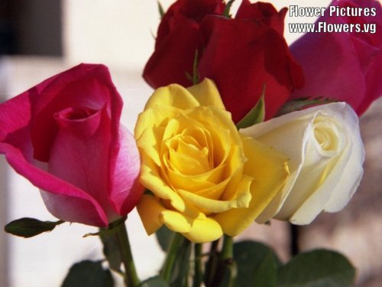
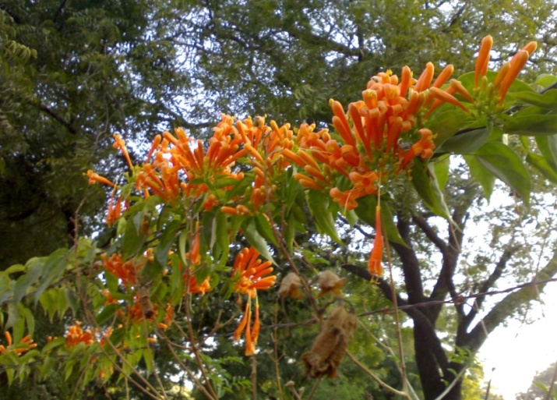
Electrodynamics-I

Slide 2
Topics
Physical Quantities (Scalar and Vector Quantities
Fields (Scalar Field and Vector Field
Gradient, Divergence and Curl

Slide 3
Cont…..
Fundamental theorem of Divergence
Or
Gauss Divergence Theorem
Fundamental theorem of Curl
Or
Stokes’ Theorem

Slide 4
Physical Quantities
Physical Quantities: A physical quantity is a physical property of a body, or substance, that can be quantified by measurement. or
Property of a body, or substance, where the property has a magnitude that can be expressed as a number and a reference.
Hence the value of a physical quantity A can be expressed as the product of a numerical value ‘a’ and a unit of measurement ‘u’
i.e. A = a u
For Example: If the temperature T of a body is quantified as 300 Kelvin (in which T is the quantity symbol, 300 the value, and K is the unit), this is written T = 300 X K = 300K

Slide 5
Scalar Quantities
A scalar is a quantity that has a magnitude but has no direction associated with it. Examples include: length, temperature, mass, electric charge, work, density, pressure, speed, etc. Once units have been specified these quantities are characterised by single real numbers.
Examples are temperature, mass, length, electric potential, density etc.
e.g. The temperature is 21 °C, the density is 1000 kg/m³.

Slide 6
Vector Quantities
A vector is a quantity that has a magnitude and a direction associated with it. Examples include: displacement, velocity, acceleration, force.
Examples: Velocity, Acceleration, Force, Impulse,
Electric Field Intensity, Magnetic field
Intensity
To represent a vector, we introduce the concept of a directed line segment, drawn in the relevant direction and with a length corresponding to the magnitude of the quantity.

Slide 7
Field
Definition: If a physical quantity (scalar or vector) varies from point to point in a space, it can be expressed as a continuous function of the position of a point in the region of space.
The region in which the function specifies the physical quantity is called the field.
Scalar field corresponding to scalar quantities
Vector field corresponding to vector quantities

Slide 8
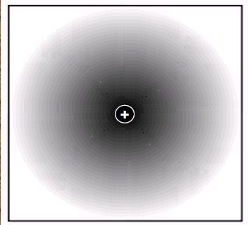
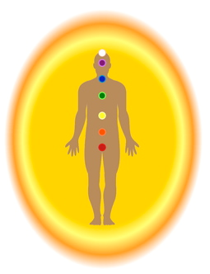
Analogy of Field with Human Aura
Field
Aura
The aura is the energy field that surrounds our body.
Electric potential around a charge

Slide 9
Scalar and Vector fields
Imagine a cooling system of a reactor which is using fluid as the cooler medium
v_{b}
v_{a}
Fluid
T_{c}
T_{d}

Slide 10
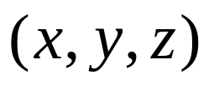
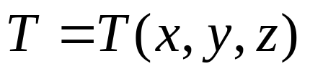
At any point P, we can measure the temperature T.
The temperature will depend upon point in the reactor where we take the measurement. Of course, the temperature will be higher close to the radiator than the surroundings.
Clearly the temperature T is a function of the position of the point. If we label the point by its Cartesian coordinates , then T will be a function of x, y and z, i.e.
This is an example of a scalar field since temperature is a scalar.

Slide 11
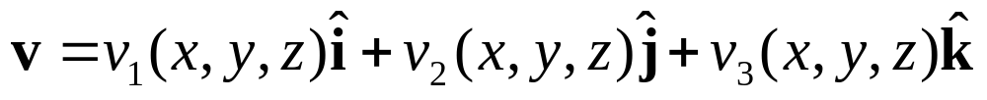
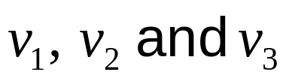
Meanwhile, at each point, the fluid will be moving with a certain speed in a certain direction
That is, each small fluid element has a particular velocity and direction, depending upon its location in the fluid.
This is an example of a vector field since velocity is a vector. The velocity can be expressed as a vector function, i.e.
where will each be scalar functions.

Slide 12
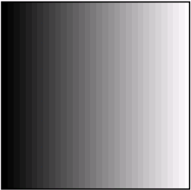
Physical examples of scalar fields:
Temperature near a heated wall
(The darker region representing higher values )

Slide 13
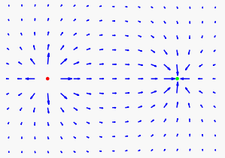
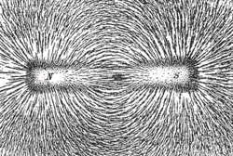
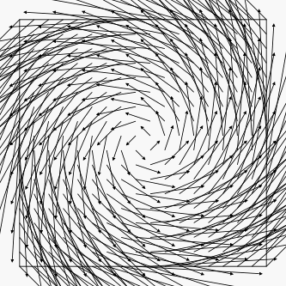
Physical examples of vector fields:
+
−
Electric field surrounding a positive and a negative charge.
Magnetic field lines shown by bar magnet
Hurricane

Slide 14
Gradient of Scalar Fields
The gradient of a scalar field is a vector field,
which points in the direction of the greatest rate of increase of the scalar field, and whose magnitude is the greatest rate of change.

Slide 15
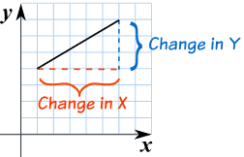
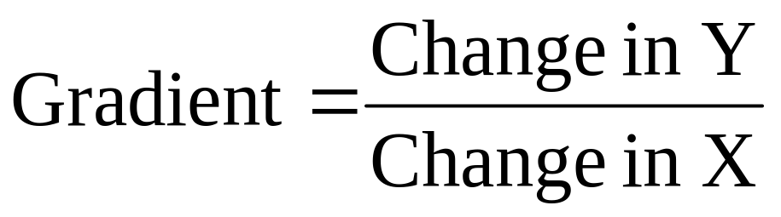
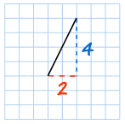
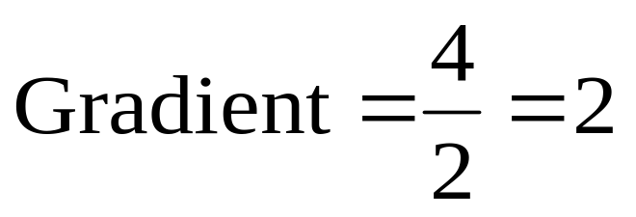
Gradient (Mathematically)
Figure: Mathematical representation of gradient.
Figure: The line is steeper, and so the Gradient is larger.

Slide 16
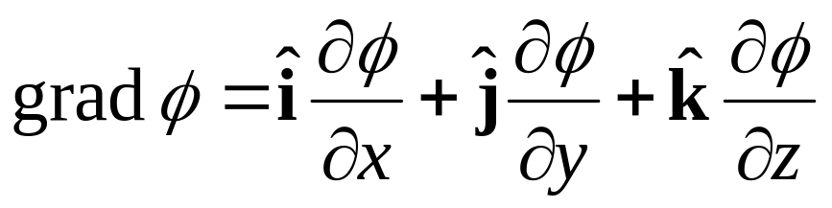
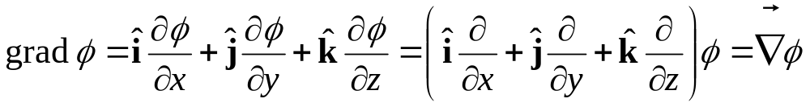
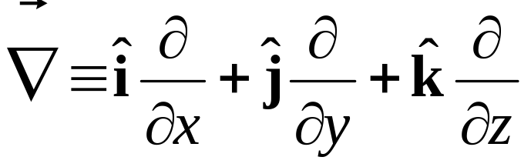
Thus, the gradient of a scalar function ϕ is equal to
Even though ϕ is a scalar, the gradient of ϕ is a vector.
The expression of grad ϕ can be written as
where the operator
is called del or nabla.

Slide 17
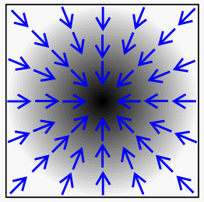
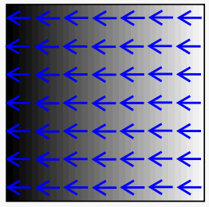
In the above two images, the scalar field is in black
and white, black representing higher values, and its
corresponding gradient is represented by blue arrows.

Slide 18
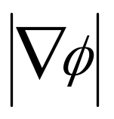
Question
If φ (x,y,z) = 3x²y– y²z², find grad φ and at the point (1,2,−1).

Slide 19
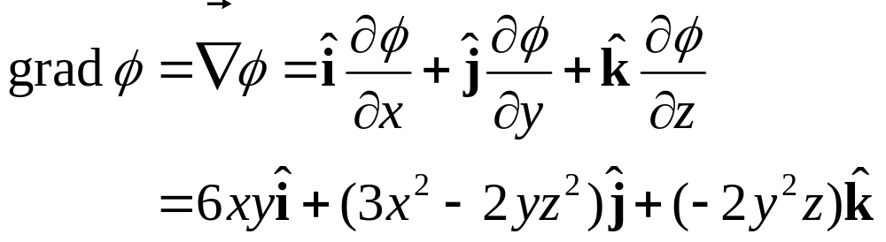
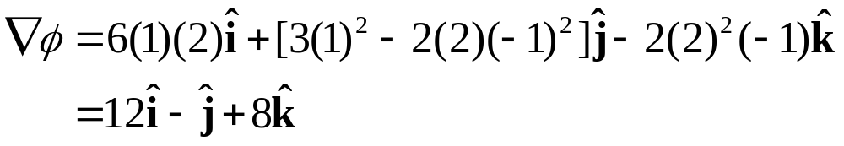
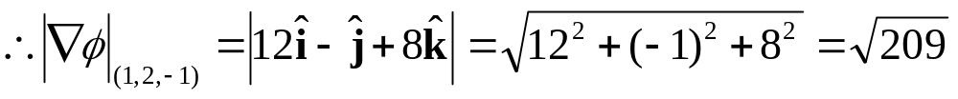
Solution
At the point (1,2,−1),

Slide 20
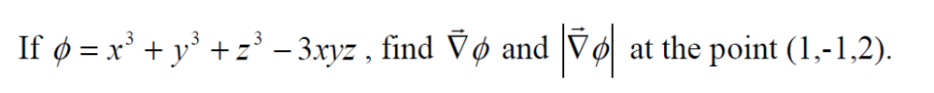
Question-2

Slide 21
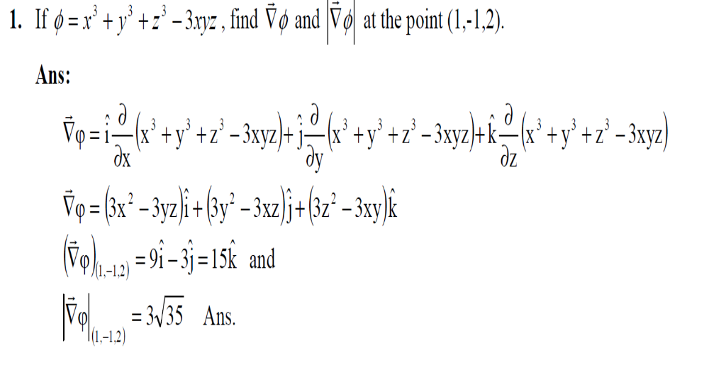
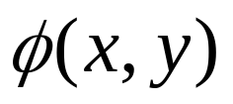
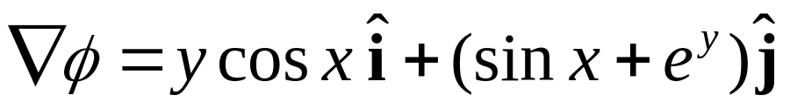
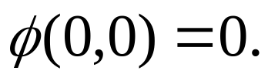
Given

Slide 22
Question-3
Find , if
Given

Slide 23
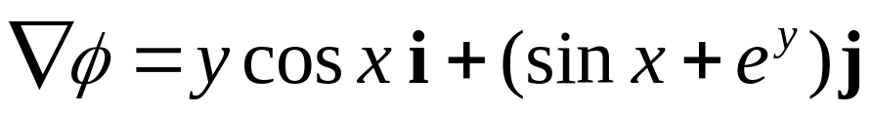
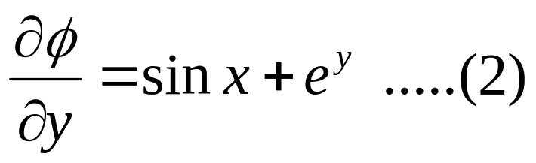
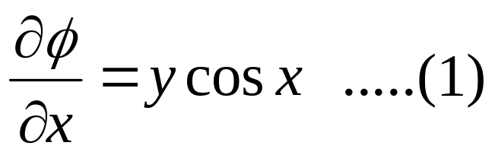
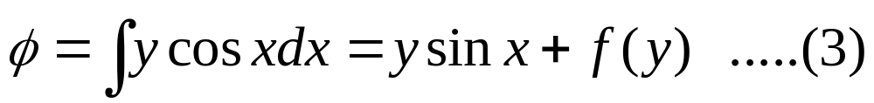
Solution
Since , we have
Integrating (1) and (2) w.r.t. x and y respectively, we obtain

Slide 24
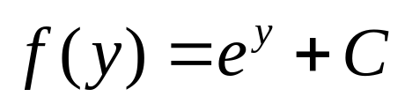
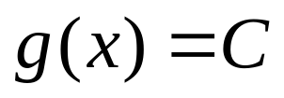
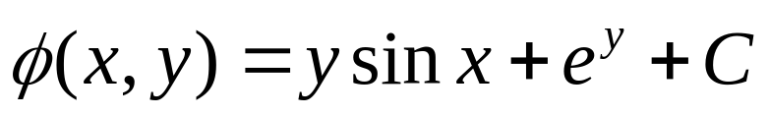
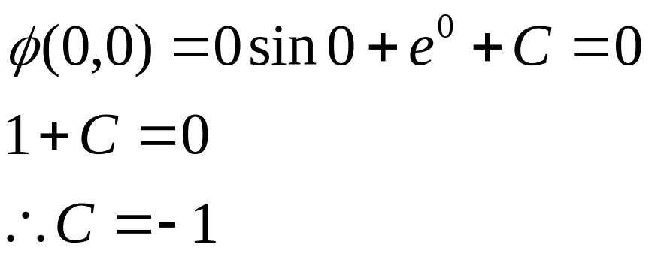
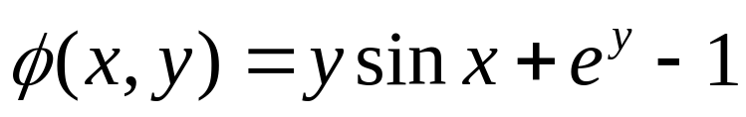
Comparing (3) and (4), we can conclude that
and
where C is an arbitrary constant of integration
Hence,
To find constant C, use
Therefore,
♣

Slide 25
Divergence of Vector Fields
The divergence is an operator that measures the magnitude of a vector field's source or sink at a given point.
The divergence of a vector field is a scalar and at a point it is defined as the amount of flux diverging from a unit volume element per second around that point.
It is a scalar product of del operator with a vector field function.

Slide 26
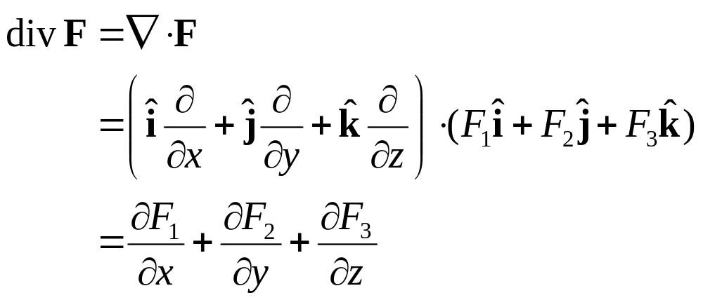
The divergence of a vector field
is defined as

Slide 27
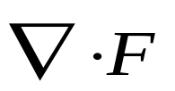
Geometrical Interpretation.
The name divergence is well chosen, for is a measure of how much the vector F spreads out (diverges) from the point in question.
The vector function has a (positive) divergence at the point P; it is spreading out. (If the arrows pointed in, it would be a negative divergence.)
P
NOTE: P=electric field due to charge (+ ve or – ve)

Slide 28
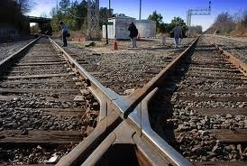
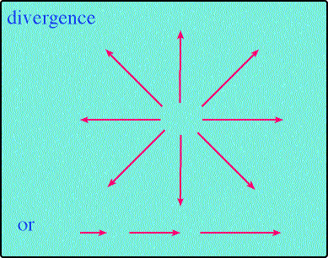
Divergence Examples
Fig2.5: Divergence of a vector field.

Slide 29
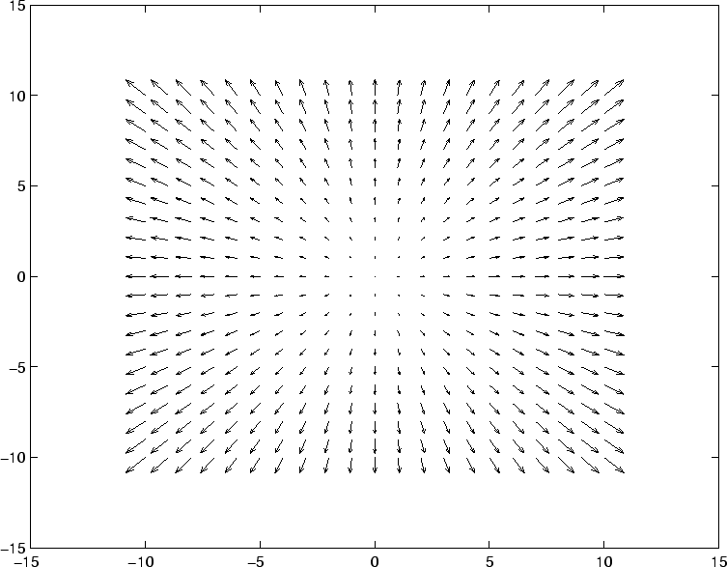
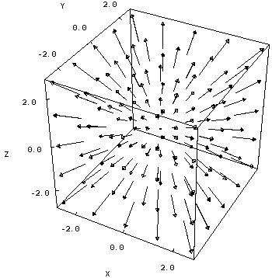
Examples of Positive Divergence

Slide 30
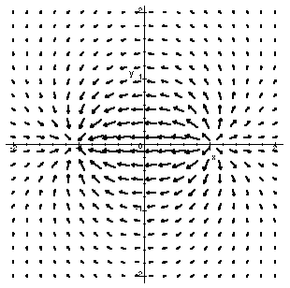
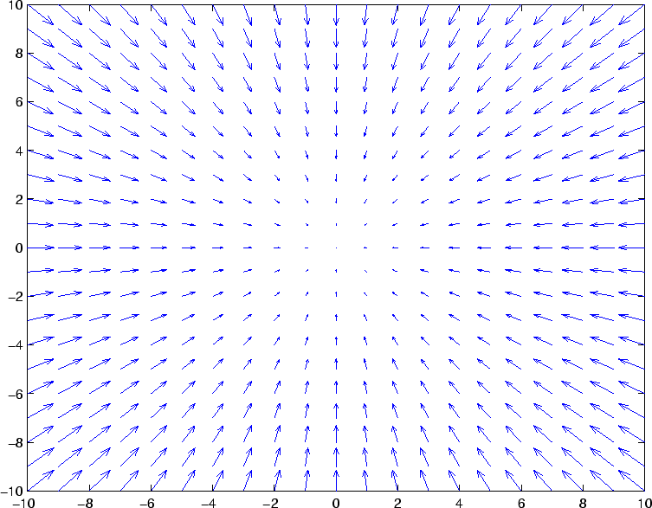
Examples of Negative Divergence

Slide 31
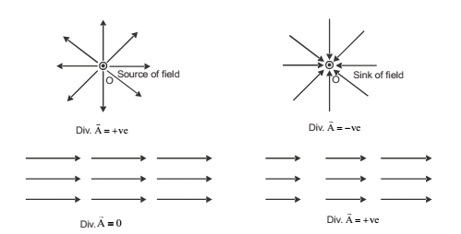
If Divergence of vector field is zero , then it is also termed Solenoidal Field

Slide 32
On the other hand, the function has zero divergence at P; it is not spreading out at all.
*Divergence-Application: used in Gauss law

Slide 33
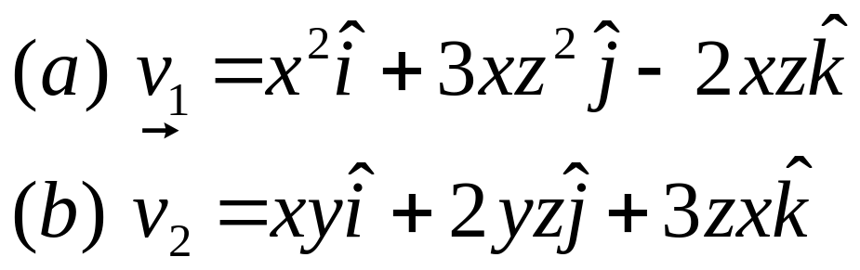
Question
Q. Calculate the divergence of the following vector functions?

Slide 34



Del Operations
Gradient
Divergence
Curl

Slide 35
Curl of Vector Fields
Measures the vector field’s tendency to rotate around a point
Curl is a vector operator that shows a vector field's rate of rotation, i.e. the direction of the axis of rotation and the magnitude of the rotation.
It is a vector product of del operator with a vector field function.

Slide 36
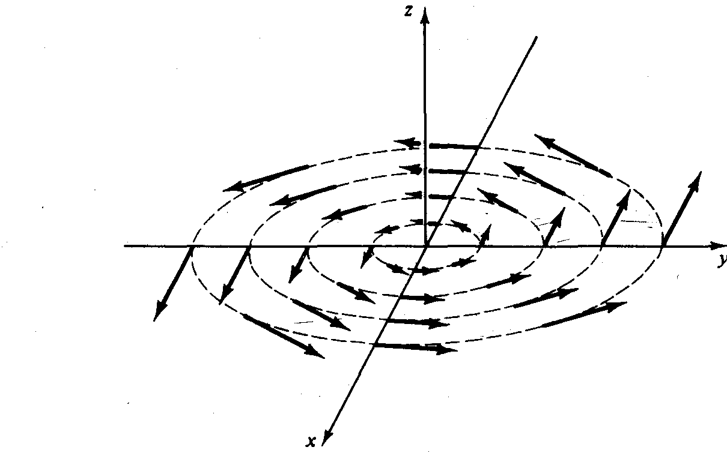
Geometrical representation of Curl:
*Curl-application: used in Ampere’s circuital law.

Slide 37

Example
Whirlpool

Slide 38



Examples
Fig3.1: Curl or Divergence of a vector field.

Slide 39

The curl of a vector field
is defined as

Slide 40


Some important points:
A vector field function is said to be irrotational if curl of the function is zero.
curl F=0 or
A vector field function is said to be solenoidal in a region if its flux across any closed surface in that region is zero.
div F=0

Slide 41

Question-4:
Find both div F and curl F at the point (2,0,3) if

Slide 42


Solution
[Notice that div F is a scalar!]
At the point (2,0,3),

Slide 43


Slide 44

[Notice that curl F is also a vector]
At the point (2,0,3),

Slide 45




Q 5. Show that the vector field is solenoidal.
Hint:
Q 6. Show that the vector field
is irrotational.
Hint:

Slide 46

Question-7:
Find the value of the constant for which the vector
is solenoidal.
Hint: For a solenoidal vector field A,
div A=0

Slide 47


